Slide 1
Adam’s Final Lecture
Thanks for making this a fun experience!
Students!
TAs!!
Josh!!!
I will probably teach EECS 255d (Audio Signal Processing in Humans and Machines) next fall.

Slide 2
Announcements
Lecture on Robotics: Tue Nov 29, 9:30-11
Homework 10: Due Wed Nov 30, 11:59pm
Final Contest: Due Fri Dec 9, 11:59pm
Daily rankings starting Sat Dec 3
Project 6: Due Mon Dec 5, 5:00pm
Final Exam: Tue Dec 13, 3-6pm

Slide 3
Speech Recognition A CS188 Perspective
Adam Janin

Slide 4
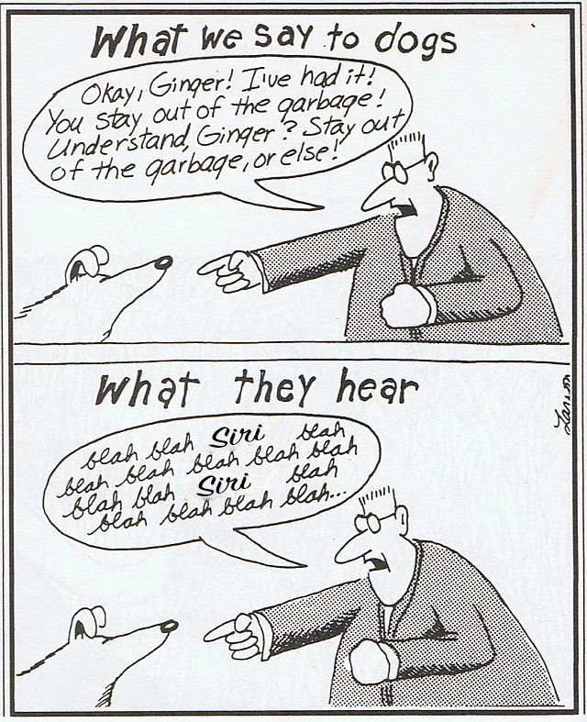

Slide 5

Why Is It Hard?
Many different ways to say the same thing.
Volume
Accent
Gender
Speaking style
Speed
Etc.
Notes:
I searched for something in the ICSI Meeting Corpus.

Slide 6
Why Is It Hard?
Word Boundaries?

Slide 7
Why Is It Hard?
Homophony – The same sounds may mean different things.
Mai numb burr is ate won ate too fore to for
wreck a nice beach
My number is 818-2424
Recognize Speech

Slide 8
Why Is It Hard?
Background noise
Reverberation
Channel effects

Slide 9
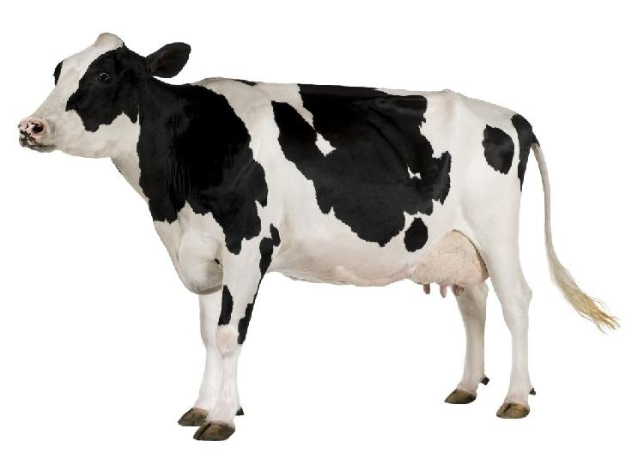
Clean Audio, One Speaker, One Word, …

Slide 10
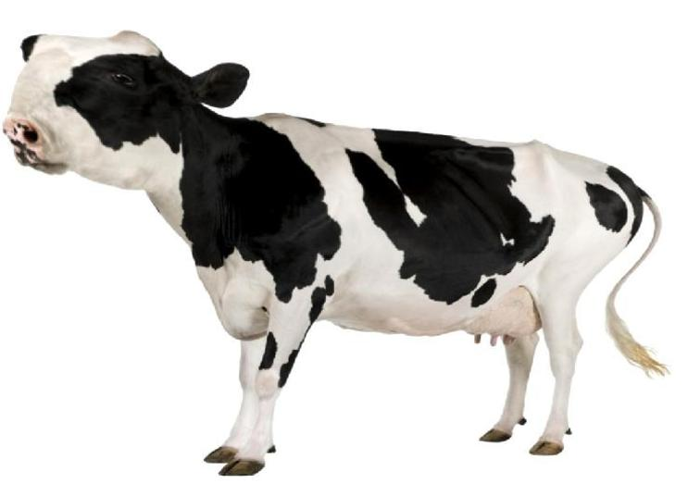
Channel Effects
Notes:
Lens aberations

Slide 11
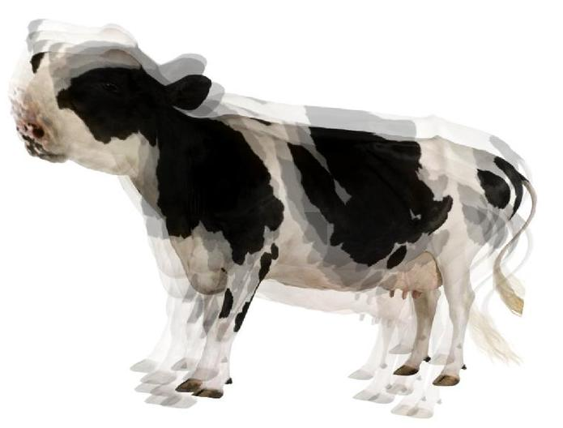
Reverberation / Echos

Slide 12
Background Noise

Slide 13
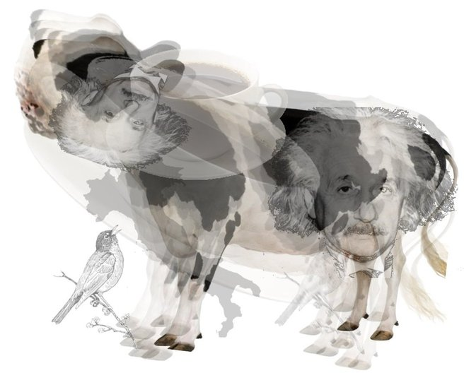
Many Background Noises!
Notes:
… and this is all without time, multiple speakers, knowing what word, etc.

Slide 14
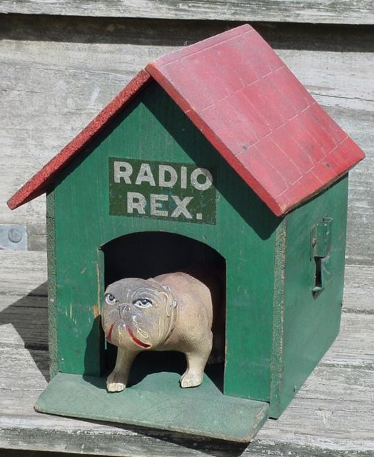
A Little History
First Consumer Electronic “Speech Recognition”?
Radio Rex – 1922
Rex would leap out of his house when you called his name.
No computer!
Electromagnet tuned to 500 Hz, just around where the “eh” sound in “Rex” is strongest.
Notes:
Thomas Edison did this in 1880s!

Slide 15
ASR Grew Up With AI
Expert Systems
"Every time I fire a linguist, the performance of the speech recognizer goes up” – Fred Jelinek, IBM, early 80s.
Nearest Neighbor
Template matching
DTW (Dynamic Time Warp)
HMM / GMM
Neural Networks
Single Words
Small vocabulary
Highly controlled acoustics
Short Phrases
Clean acoustics
Continuous Speech
Increasing vocabulary size
Increasing grammar complexity
Increasingly difficult acoustics

Slide 16
What I Wont Talk About (Much)
Connectionist Temporal Classification (CTC)
One big recurrent neural net.
Computationally expensive; currently not as accurate.
Language Modeling
Uses of ASR
What do you optimize for?
Details, Complications, Edge Cases

Slide 17
What I Will Talk About
Current Publicly Available State of the Art Systems
Kaldi, HTK
Neural Networks for Acoustic Modeling
Kaldi nnet/nnet2/nnet3, Keras, Tensorflow, Theano, many others.
Weighted Finite State Transducers (WFSTs) for Search
OpenFST

Slide 18

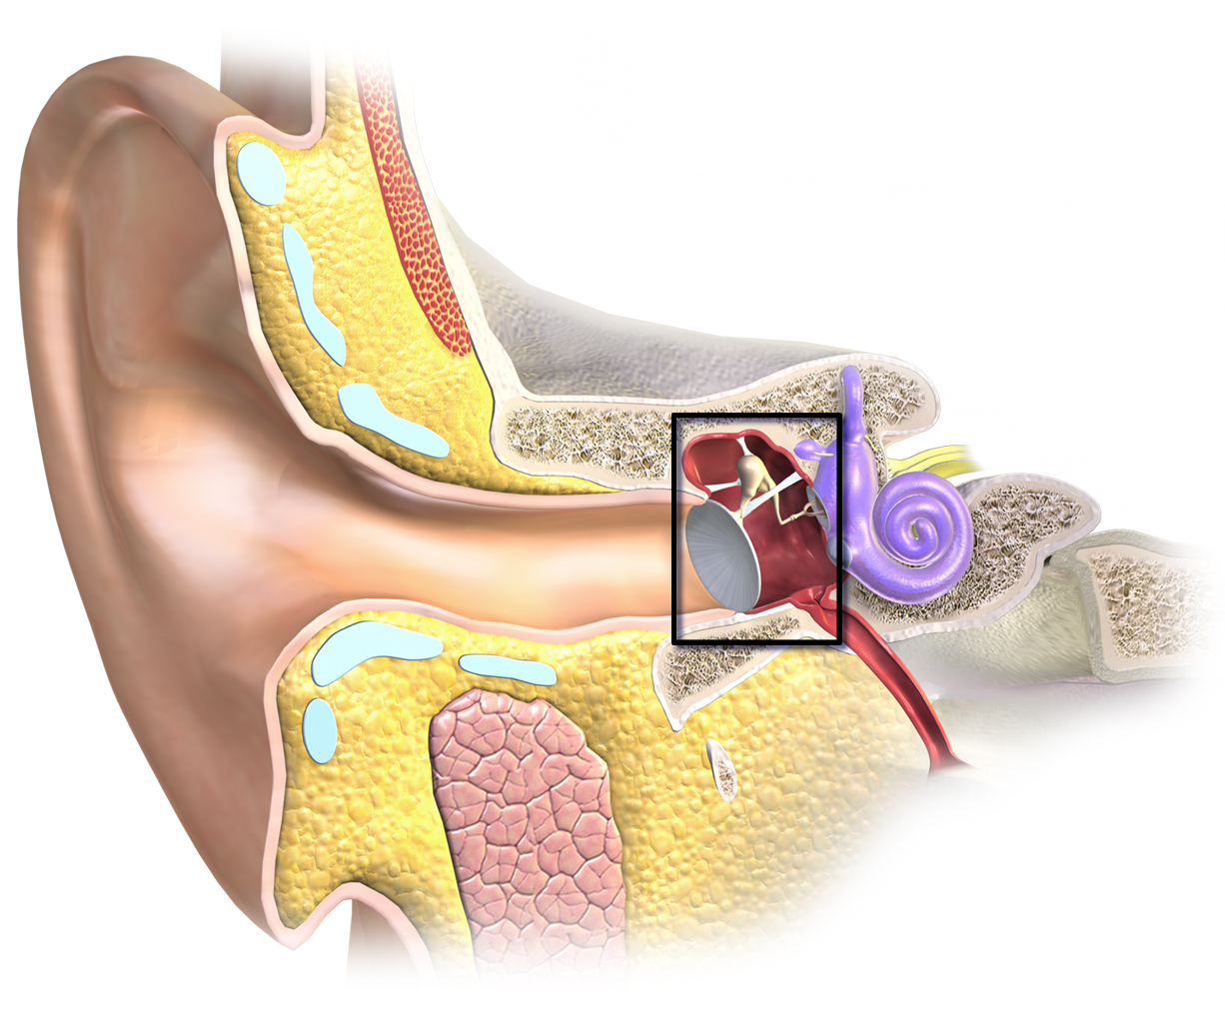
What Is Audio

Slide 19
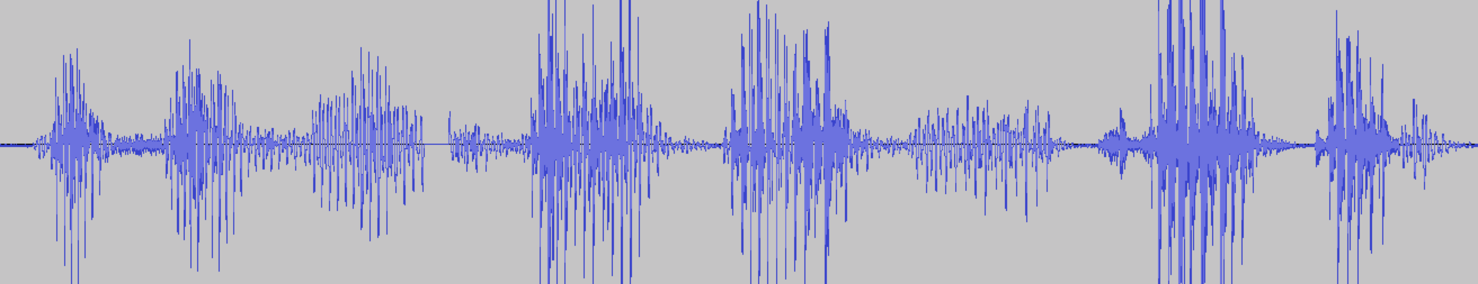
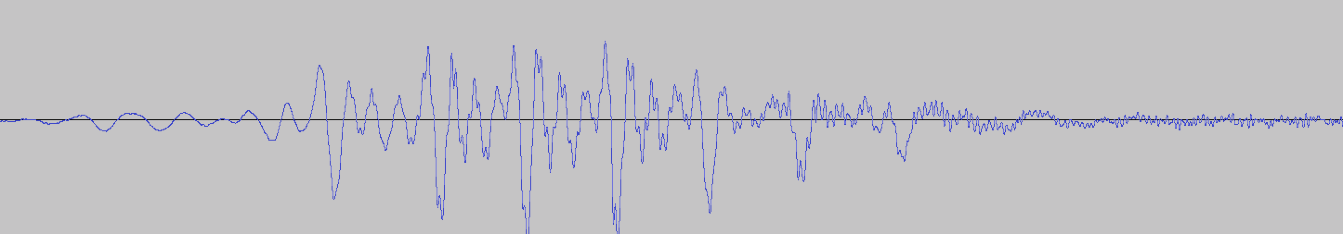
What Is Audio?
“This is an example of me talking”
“This”
Notes:
Digitized on machine at a particular rate. 44kHz for music. 16kHz for talking.

Slide 20
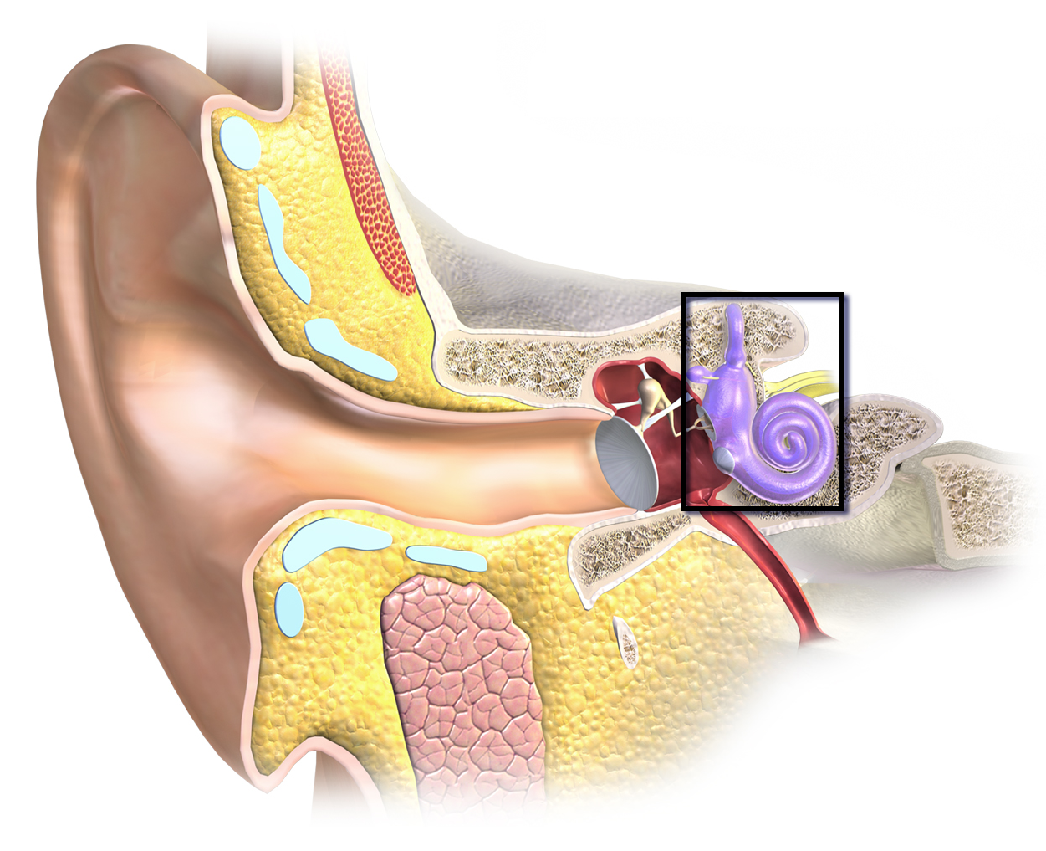
Spectrograms

Slide 21
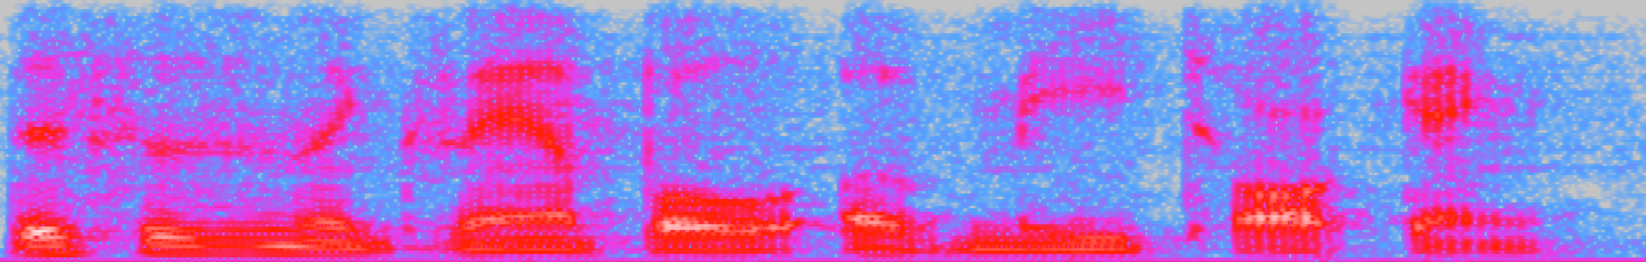
Audio Spectrogram
“This is an example of me talking”
Time on horizontal axis.
Frequency (tone) on vertical axis.
Color is amount of energy in that frequency range.
Notes:
Features on this slide (like raising and falling lines) are what linguists did hard-coding on.

Slide 22
Audio Features
“This is an example of me talking”
A feature is the total energy in a region of the spectrogram.
Humans are less sensitive to higher frequencies.
Usually uniform in time (100/second = 10ms)
Known as a frame.
More like what the ear sends to higher regions in the brain.
Notes:
Typically 13 boxes / numbers every 10 ms.
MFCC

Slide 23
Start Simple: Single Word Recognition
Training data are audio files, each with a single word in it. Is the word “zero” or “one”?
What algorithm that you already know could you use to solve this if you had a huge number of examples and lots of compute?
Hint: It would be naïve to use this algorithm.
Why would this be terrible if you did not have a huge number of examples?
Hint: How many features are there in each audio file?

Slide 24
Solution: Model Subparts of the Word
ZERO Z IH R OW
ONE W AH N
TWO T UW
THREE TH R IY
FOUR F AO R
FIVE F AY V
SIX S IH K S
SEVEN S EH V AH N
EIGHT EY T
NINE N AY N
Pronunciation Dictionary (e.g. CMUDICT)
Notes:
Not quite enough because we don’t know how long each phone takes. Model time.

Slide 25
Solution: Model Subparts of the Word
Too Scary!

Slide 26
Less Scary: Weather
Clear for a few days, then cloudy for a few days, then rain for a few days.
Notes:
How many days does this represent? Min? Max?

Slide 27
Weather Markov Chain
Transition Graph
W₁
W₂
W₃
W₄
W_{n}
Bayes’ Net (Markov Chain)
n Days of Weather

Slide 28
Weather Hidden Markov Model
Transition Graph
W₁
W₂
W₃
W₄
W_{n}
Bayes’ Net (HMM)
n Days of Weather
E₁
E₂
E₃
E₄
E_{n}

Slide 29
“One” Hidden Markov Model
Transition Graph
q₁
q₂
q₃
q₄
q_{n}
Bayes’ Net (HMM)
n Frames of Acoustics
X₁
X₂
X₃
X₄
X_{n}
Notes:
Changed to q and X just to be consistent with literature on ASR.

Slide 30
If I gave you all the CPTs, what algorithm would you use to compute the probability of “one” given the acoustic features? E.g. P(q1, q2, … qn | X1, X2, ... Xn).
Transition Graph
q₁
q₂
q₃
q₄
q_{n}
Bayes’ Net (HMM)
n Frames of Acoustics
X₁
X₂
X₃
X₄
X_{n}
Notes:
Answer: Forward Algorithm (slightly modified, but same structure).

Slide 31
If I gave you all the CPTs, what algorithm would you use to compute how long the person said “ah” assuming they did say “one”?
Transition Graph
q₁
q₂
q₃
q₄
q_{n}
Bayes’ Net (HMM)
n Frames of Acoustics
X₁
X₂
X₃
X₄
X_{n}
Notes:
Answer: Viterbi

Slide 32
Isolated Word Recognizer
Run an HMM for each word.
Pick the one with the highest probability!
Problems:
Scalability – 100,000 word vocabulary
Repeated work – “t” in ”two” vs. “t” in “ten”.
Sentences have more than one word!
Haven’t told you how to compute CPTs.

Slide 33
Avoiding Repeated Work
Build a graph for each word.
Combine where possible.
Lots of theory behind this.
Weighted Finite State Transducers
The toolkit OpenFST will do it all for you.

Slide 34
Avoiding Repeated Work
Build a graph for each word.
Combine where possible.
Lots of theory behind this.
Weighted Finite State Transducers
The toolkit OpenFST will do it all for you.

Slide 35
Avoiding Repeated Work
New Notation on Arcs
x:y – When you traverse the arc, consume “x” and emit “y”.
<eps> - Epsilon. On input, do not consume any input. On output, do not emit any output.
For any word/pronunciation, notice that all input is consumed and one word is output.

Slide 36
Avoiding Repeated Work
Next slide has a big example:
bad, badge, bag, bid, big, bud, budge, bug
The example uses letters rather than phonemes to make it easier to read.
The process to generate the graph is fully automated once you have pronunciations.
The data structure is known as a “decoding graph”.

Slide 37
bad, badge, bag, bid, big, bud, budge, bug

Slide 38
Inference on Decoding Graph
Summing over all paths in the search tree would yield the probability that the file contained any of bad, badge, etc.
How do we tell which word was actually there?
Cast your mind back to the very beginning of the term…

Slide 39
Inference on Decoding Graph
Typically we do not use A* because:
Hard to find a heuristic.
We want not just the best path, but the scores of the best few words.
Believe it or not, we use the much-maligned BFS!
BFS made tractable using “pruning”.
Throw out members of the fringe that are not close to the best score on the fridge. Do this at each step.
Not optimal or complete, but works well in practice.

Slide 40
Continuous Speech Recognition
What if the file contains more than one word?
Example: “big bad badge bug bud”
Very complex, so pay close attention!

Slide 42
Continuous Speech Recognition
Okay, so that was a bit glib…
In the real case, not all sentences have equal probability.
This is encoded in the language model.
See Midterm 2 question 2 (Pacmanian Language Modeling) for how we compute the language model.
Can be encoded in the decoding graph in a mechanical way.
Lots of interesting theory and practice, but not enough time to cover.

Slide 43
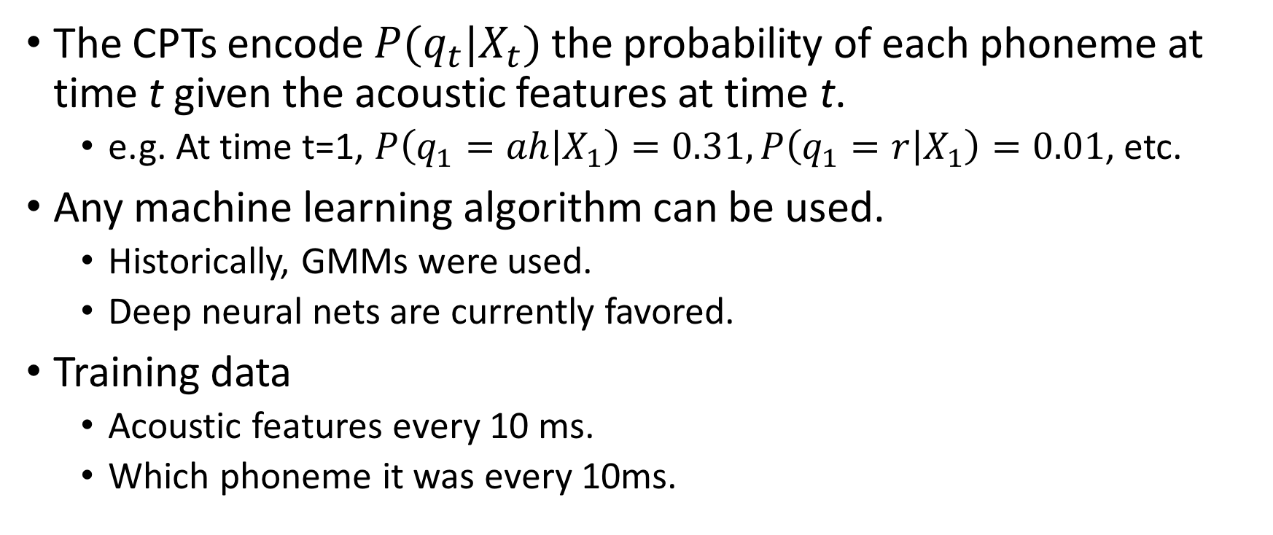
Where Do We Get the CPTs?
The CPTs encode $P(q_{t}|X_{t})$ the probability of each phoneme at time t given the acoustic features at time t.
e.g. At time t=1, $P\left(q_{1}=ah | X_{1}\right)=0.31, P\left(q_{1}=r | X_{1}\right)=0.01$, etc.
Any machine learning algorithm can be used.
Historically, GMMs were used.
Deep neural nets are currently favored.
Training data
Acoustic features every 10 ms.
Which phoneme it was every 10ms.

Slide 44
Training
Computing features is usually easy.
Where do labels come from?
Some corpora label every 10ms chunk of time with a phoneme. Extremely labor intensive, and only a tiny amount of data available.
Most corpora label with the sequence of words in each audio file.
Going from the sequence of words to the sequence of phonemes is known as forced alignment.

Slide 45
Forced Alignment
Construct a decoding graph with just the sequence of words that was actually spoken.
This results in a much smaller search graph.
Run the normal algorithm.
Example: “big bad badge”

Slide 46
Bootstrapping
How can we “run the normal algorithm” if we haven’t already trained it?!?
Bootstrapping.
Start with another system.
“Flat Start”: Train a system where you assume each phoneme is of equal length. This is a terrible assumption, but you can then rerun a few times and it tends to converge.

Slide 47
Summary
Acoustic features are binned energies from spectrograms (usually with additional processing).
Words are decomposed into phonemes using a pronunciation dictionary.
An HMM is formed from the phonemes with features as evidence.
The CPTs come from deep neural networks.
A language model weights likely sentences higher than unlikely ones.
A decode graph represents all possible sequences of all possible pronunciations of all possible words.
A search through the decode graph gives you the most likely sequence of words.

Slide 48
Further Reading
Nuts and Bolts
Speech and Language Processing. Jurafsky and Martin.
Broad Topics on Audio
Speech and Audio Signal Processing: Processing and Perception of Speech and Music. Gold, Morgan, and Ellis.
History
The Voice in the Machine: Building Computers That Understand Speech. Roberto Pieraccini

Slide 49
Complications
I glossed over how language models are integrated into the decoding graph. There is lots of interesting theory and practice on it.
Language models always use backoffs – if there aren’t enough examples in the corpus of three words in a row, you combine the two sequences of two words in a row to get a smooth estimate of the trigram.
Smoothing of language models is very important in accounting for words you haven’t seen.

Slide 50
Complications
The way one pronounces e.g. “eh” depends on the phonemes around it. We model this with triphones. For example, the pronunciation of “seven” is:
$ s eh s eh v eh v ah v ah n ah n $
There are many methods to normalize features so that they are more similar from speaker to speaker. Just making the features have mean=0.0 and variance=1.0 helps. Other methods: VTLN, MLLR, fMLRT, etc.

Slide 51
Complications
There are many methods of removing noise from audio before computing features. Examples: Spectral mean subtraction, Wiener Filtering, Beam Forming, CASA, etc.
There are many many features one can use, each with many variants and many parameters. You often need to tune the parameters on the held-out set.

Slide 52
Complications
The neural networks used to compute the CPTs can be very complex. We’ve only touched the surface on methods used.
Similarly, the language models can be very complex. For example, we often train on multiple language models and combine them.
There are many techniques for handling words where you don’t have the pronunciation. These are known as “out of vocabulary” or OOV words.

Slide 53
Complications
State of the art systems are usually system combinations of many systems. They might have 10 different neural nets for computing CPTs, 5 language models, multiple dictionaries, etc.
Languages other than English can have issues. For example, in Nunavut Inuktitut (= Eskimo) the word tusaatsiarunnanngittualuujunga means “I can't hear very well”. In languages like this, the vocabulary is too big to fit in memory. You have to break words into pieces.

Slide 54
Complications
Although there aren’t generally pauses between words, there can be. Pause handling can be tricky in the decoding graph.
Generating more than just the best hypothesis can be difficult. There is a compact data structure known as a lattice that can encode the list of hypotheses.
Often, you will generate lattices using a simpler system, then rescore the lattice using a more complex system.

